Slide 1
Lecture 3 Sorting Algorithms
Ran Cheng (程然)
https://chengran.tech/
https://emi.sustech.edu.cn/

Slide 2
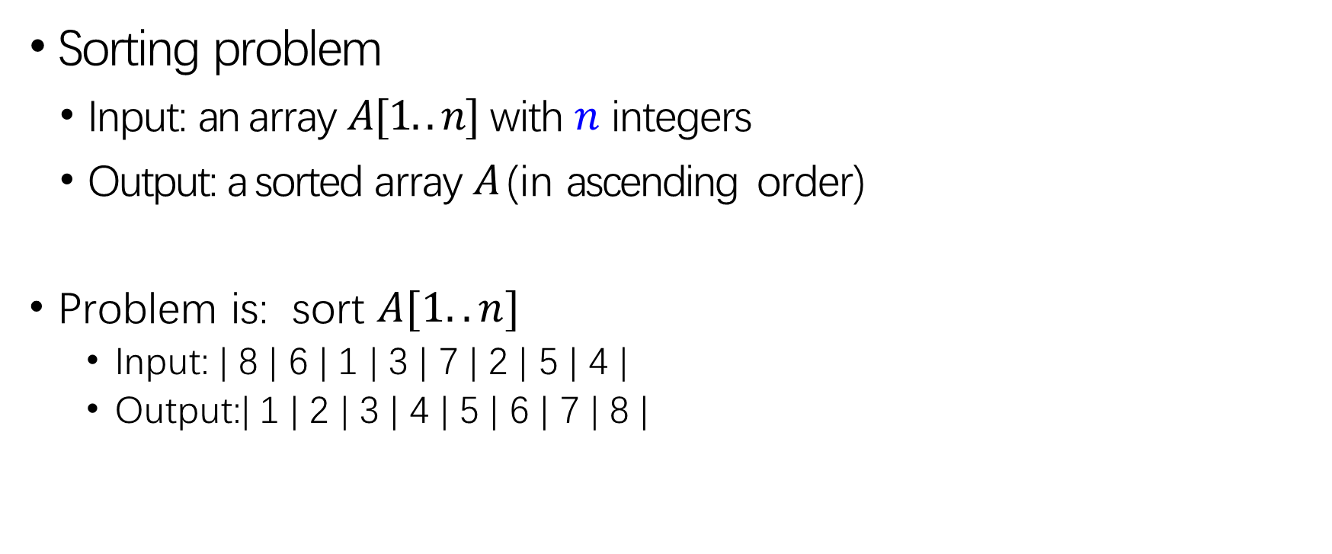
Sorting Problem
Sorting problem
Input: an array $A[1..n]$ with $n$ integers
Output: a sorted array $A$ (in ascending order)
Problem is: sort $A[1..n]$
Input: | 8 | 6 | 1 | 3 | 7 | 2 | 5 | 4 |
Output:| 1 | 2 | 3 | 4 | 5 | 6 | 7 | 8 |

Slide 3
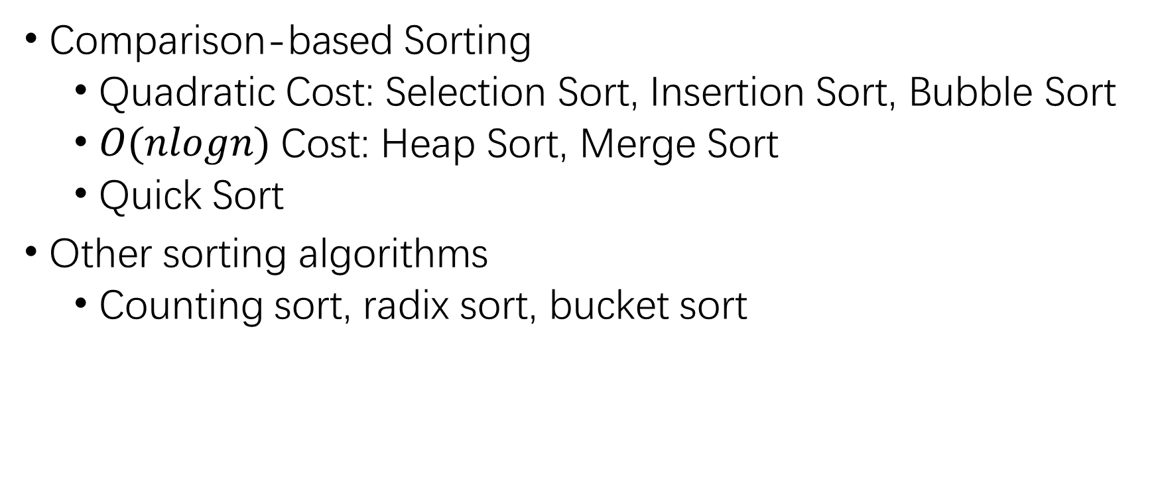
Our Roadmap
Comparison-based Sorting
Quadratic Cost: Selection Sort, Insertion Sort, Bubble Sort
$O(nlogn)$Cost: Heap Sort, Merge Sort
Quick Sort
Other sorting algorithms
Counting sort, radix sort, bucket sort

Slide 4
Selection Sort
Comparison-based Sorting of Quadratic Cost

Slide 5
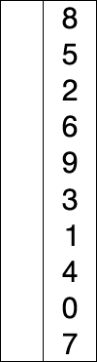

Idea
Idea of a selection sort method:
Start with empty hand, all cards on table
Pick the smallest card from table
Insert the card into the hand

Slide 6
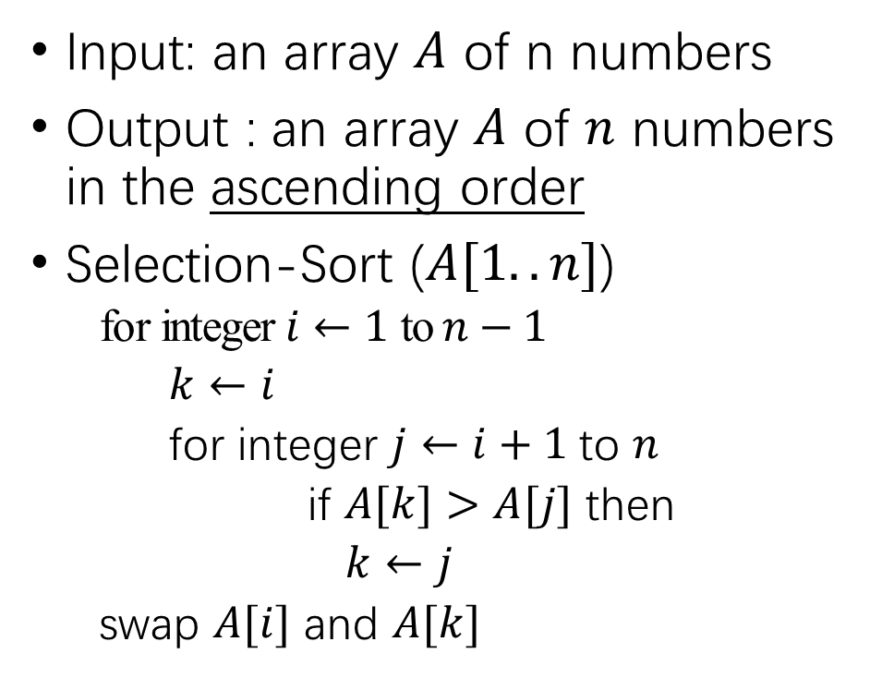
Algorithm
Input: an array $A$ of n numbers
Output : an array $A$ of $n$ numbers in the ascending order
Selection-Sort ($A[1..n]$)
for integer $i←1$ to $n−1$
$k←i$
for integer $j←i+1$to $n$
if $A[k]>A[j]$ then
$k←j$
swap $A[i]$ and $A[k]$
8 | 6 | 1 | 3 | 7 | 2 | 5 | 4
1 | 6 | 8 | 3 | 7 | 2 | 5 | 4
sorted unsorted
1 | 2 | 8 | 3 | 7 | 6 | 5 | 4
sorted unsorted

Slide 7
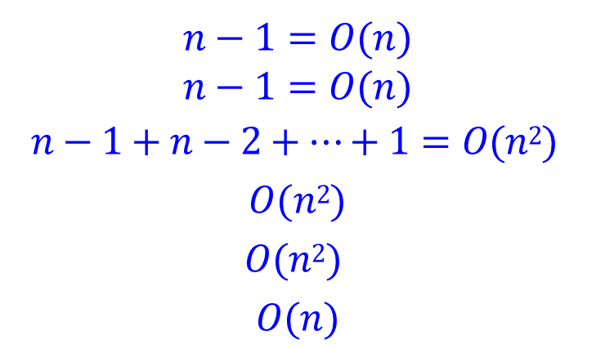
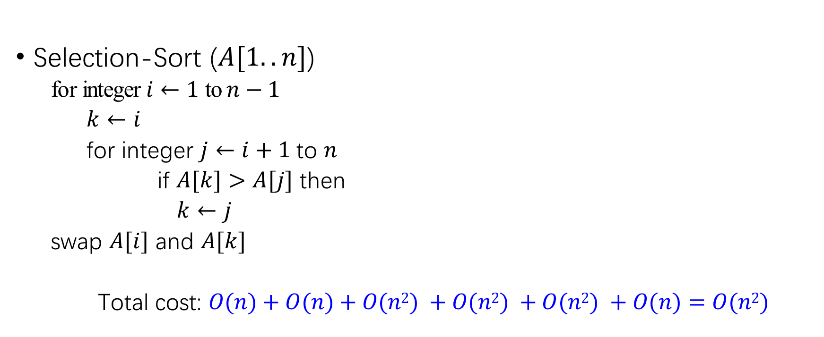
Time Complexity
Selection-Sort ($A[1..n]$)
for integer $i←1$ to $n−1$
$k←i$
for integer $j←i+1$to $n$
if $A[k]>A[j]$ then
$k←j$
swap $A[i]$ and $A[k]$
Total cost: $O(n)+O(n)+O(n2) +O(n2) +O(n2) +O(n)=O(n2)$
$$n−1=O(n)$$
$$n−1=O(n)$$
$$n−1+n−2+…+1=O(n2)$$
$$O(n2)$$
$$O(n2)$$
$$O(n)$$

Slide 8
Bubble Sort
Comparison-based Sorting of Quadratic Cost

Slide 9


Idea
Idea of a bubble sort method:
For each pass
Compare the pair of adjacent item
Swap them if they are in the wrong order
Repeat the pass through until no swaps are needed

Slide 10
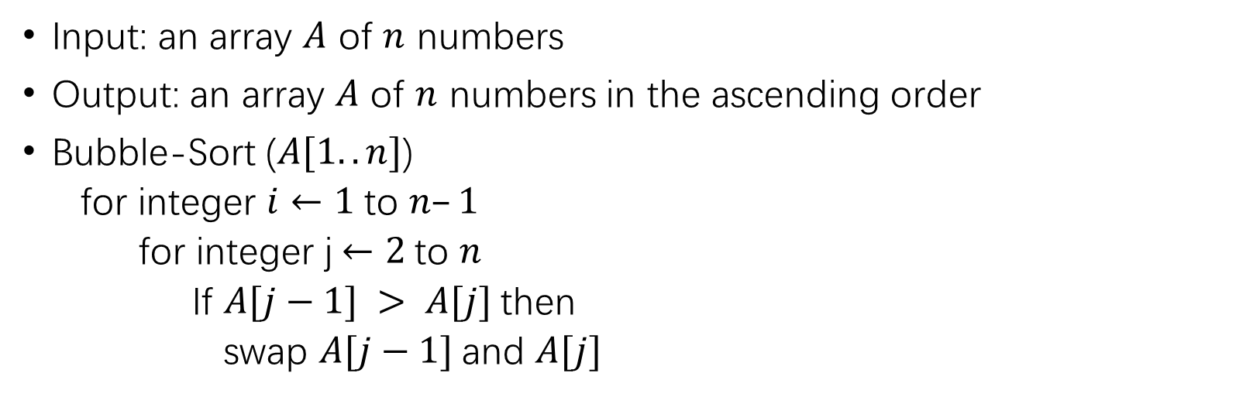
Algorithm
Input: an array $A$ of $n$ numbers
Output: an array $A$ of $n$ numbers in the ascending order
Bubble-Sort ($A[1..n]$)
for integer $i←1$to $n–1$
for integer j$←2$to $n$
If $A[j−1] > A[j]$then
swap $A[j−1]$and $A[j]$
8 | 6 | 1 | 3 | 7 | 2 | 5 | 4
1 | 3 | 6 | 2 | 5 | 4 | 7 | 8
unsorted sorted
unsorted sorted
6 | 1 | 3 | 7 | 2 | 5 | 4 | 8
1 | 3 | 2 | 5 | 4 | 6 | 7 ¹| 8

Slide 11
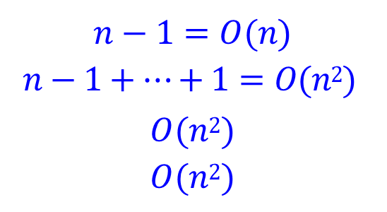
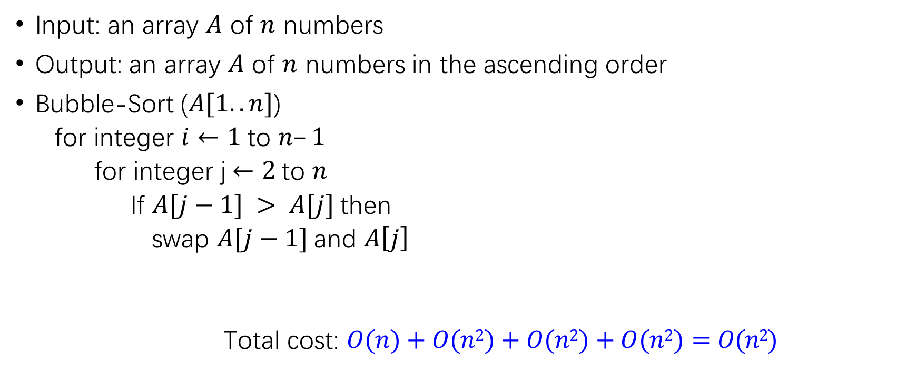
Time Complexity
Input: an array $A$ of $n$ numbers
Output: an array $A$ of $n$ numbers in the ascending order
Bubble-Sort ($A[1..n]$)
for integer $i←1$to $n–1$
for integer j$←2$to $n$
If $A[j−1] > A[j]$then
swap $A[j−1]$and $A\left[j\right]$
Total cost: $O(n)+O(n2)+O(n2)+O(n2)=O(n2)$
$$n−1=O(n)$$
$$n−1+…+1=O(n2)$$
$$O(n2)$$
$$O(n2)$$

Slide 12
Insertion Sort
Comparison-based Sorting of Quadratic Cost

Slide 13
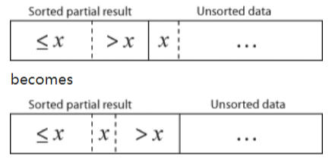

Idea
Idea of a insertion sort method
One input each iteration, growing a sorted output list
Remove one element from input data
Find the location it belongs within the sorted list
Repeat until no input elements remain

Slide 14
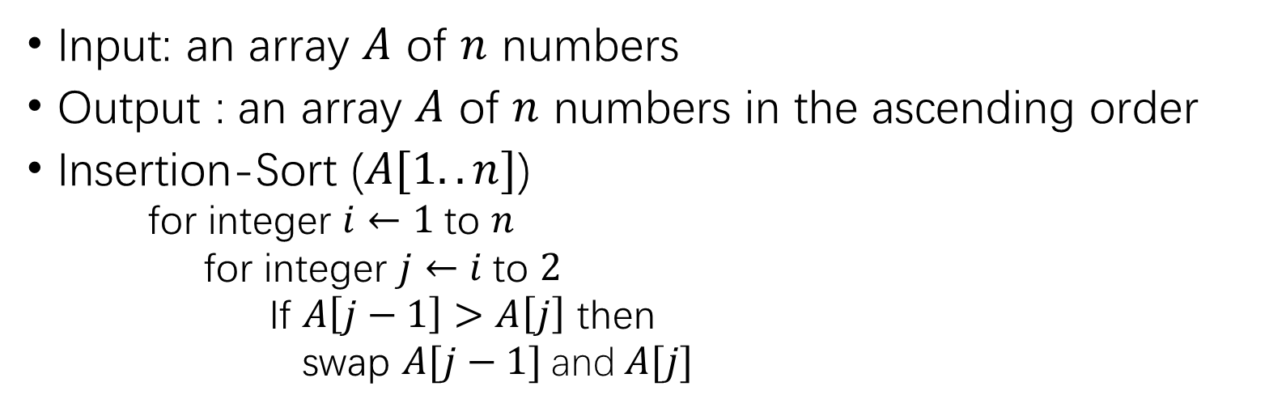
Algorithm
Input: an array $A$ of $n$ numbers
Output : an array $A$ of $n$ numbers in the ascending order
Insertion-Sort ($A[1..n]$)
for integer $i←1$to $n$
for integer $j←i$to $2$
If $A\left[j−1\right]>A\left[j\right]$ then
swap $A[j−1]$and$A[j]$
8 | 6 | 1 | 3 | 7 | 2 | 5 | 4
6 | 8 | 1 | 3 | 7 | 2 | 5 | 4
sorted unsorted
sorted unsorted
8 | 6 | 1 | 3 | 7 | 2 | 5 | 4
1 | 6 | 8 | 3 | 7 | 2 | 5 | 4

Slide 15
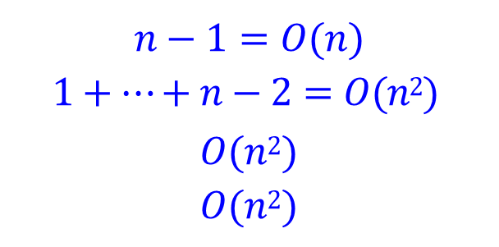
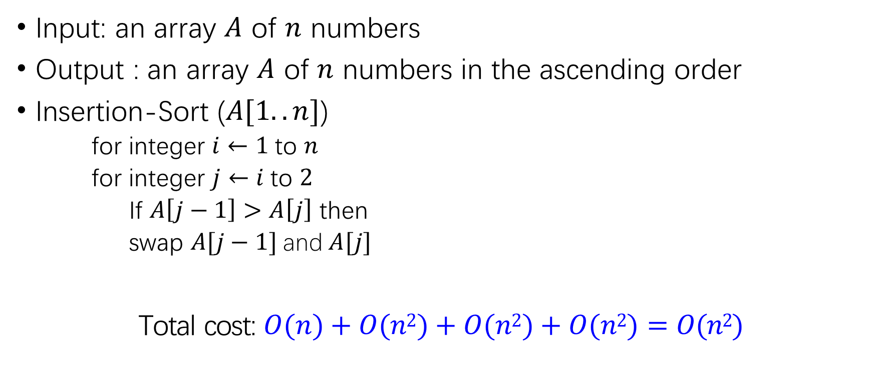
Complexity
Input: an array $A$ of $n$ numbers
Output : an array $A$ of $n$ numbers in the ascending order
Insertion-Sort ($A[1..n]$)
for integer $i←1$to $n$
for integer $j←i$to $2$
If $A\left[j−1\right]>A\left[j\right]$ then
swap $A[j−1]$and$A[j]$
Total cost: $O(n)+O(n2)+O(n2)+O(n2)=O(n2)$
$$n−1=O(n)$$
$$1+…+n−2=O(n2)$$
$$O(n2)$$
$$O(n2)$$

Slide 16
Bubble Sort VS Insertion Sort

Slide 17
Fun Quiz
We say a sorting algorithm is “stable” if it does not change the relative order of elements with equal keys, which of the following is/are stable ( )
A: Selection Sort B: Insertion Sort C: Bubble Sort
Hint: 5 8 5 2 9

Slide 18
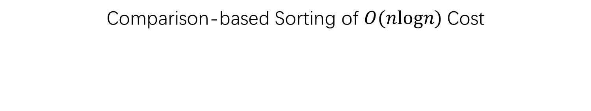
Heap Sort
Comparison-based Sorting of $O(nlogn)$Cost

Slide 19

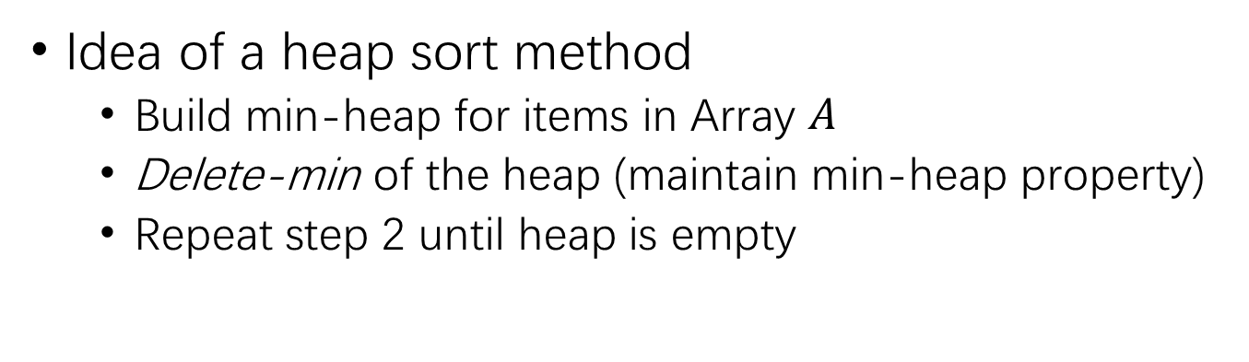
Idea
Idea of a heap sort method
Build min-heap for items in Array $A$
Delete-min of the heap (maintain min-heap property)
Repeat step 2 until heap is empty
1
3
2
4
5
6
8
7

Slide 20
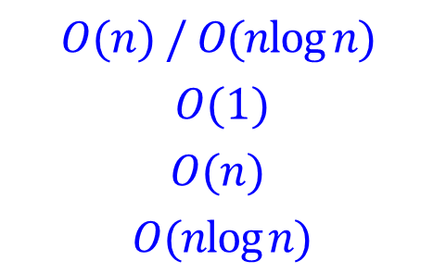
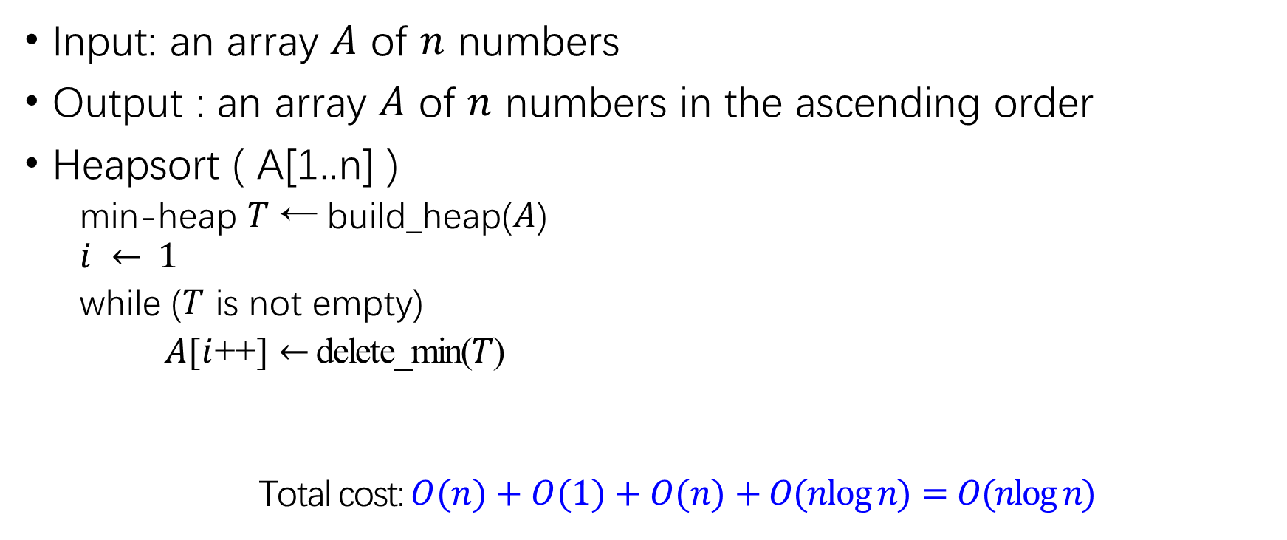
Algorithm
Input: an array $A$ of $n$ numbers
Output : an array $A$ of $n$ numbers in the ascending order
Heapsort ( A[1..n] )
min-heap $T$ ← build_heap($A$)
$$i ← 1$$
while ($T$ is not empty)
$A$[$i$++] $←$ delete_min($T$)
Total cost: $O(n)+O(1)+O(n)+O(nlog⁡n)=O(nlog⁡n)$
$$O(n) / O(nlog⁡n)$$
$$O(1)$$
$$O(n)$$
$$O(nlog⁡n)$$

Slide 21
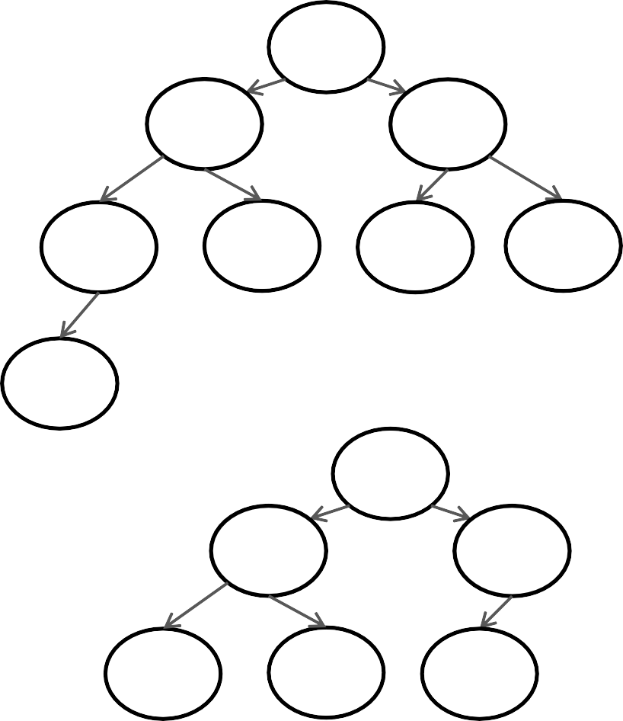

Demo
1
2
3
2
3
5
4
7
8
5
4
7
8
6
6
1
3
4
5
8 | 6 | 1 | 3 | 7 | 2 | 5 | 4
6 7
8
1 | 3 | 2 | 4 | 7 | 8 | 5 | 6
Heap
1 | 2
2 | 3 | 5 | 4 | 7 | 8 | 6
Delete-min
3 | 4 | 5 | 6 | 7 | 8
Delete-min

Slide 22
Merge Sort
Comparison-based Sorting of $O(nlogn)$Cost

Slide 23
Idea
Divide and Conquer: an algorithmic technique
Divide: divide the problem into smaller subproblems
Conquer: solve each subproblem recursively
Combine: combine the solution of subproblems into the solution of the original problem
1. divide
n
3. combine
n/b
n/b
…
n/b
2. conquer

Slide 24
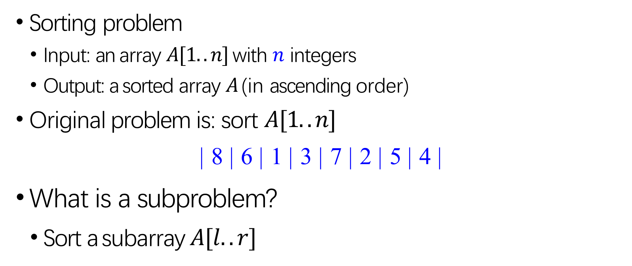
Idea
Sorting problem
Input: an array $A[1..n]$with $n$ integers
Output: a sorted array $A$ (in ascending order)
Original problem is: sort $A[1..n]$
| 8 | 6 | 1 | 3 | 7 | 2 | 5 | 4 |
What is a subproblem?
Sort a subarray $A[l..r]$
| 7 | 2 | 5 | 4 |

Slide 25
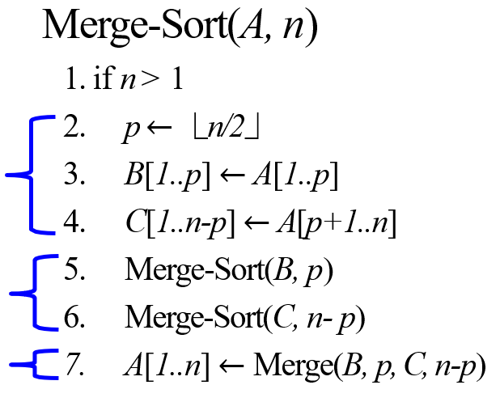
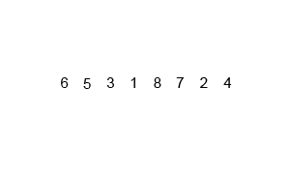
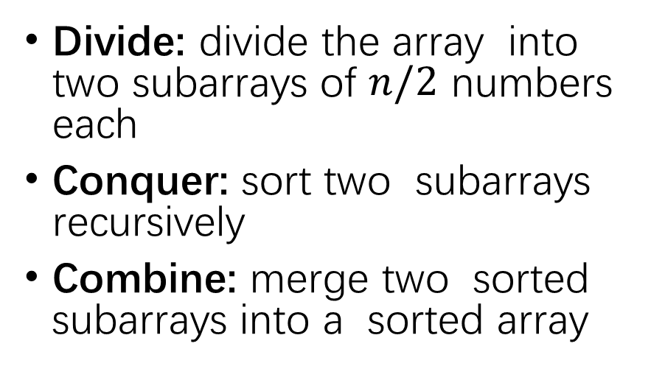
Algorithm
Divide: divide the array into two subarrays of $n/2$ numbers each
Conquer: sort two subarrays recursively
Combine: merge two sorted subarrays into a sorted array

Slide 26
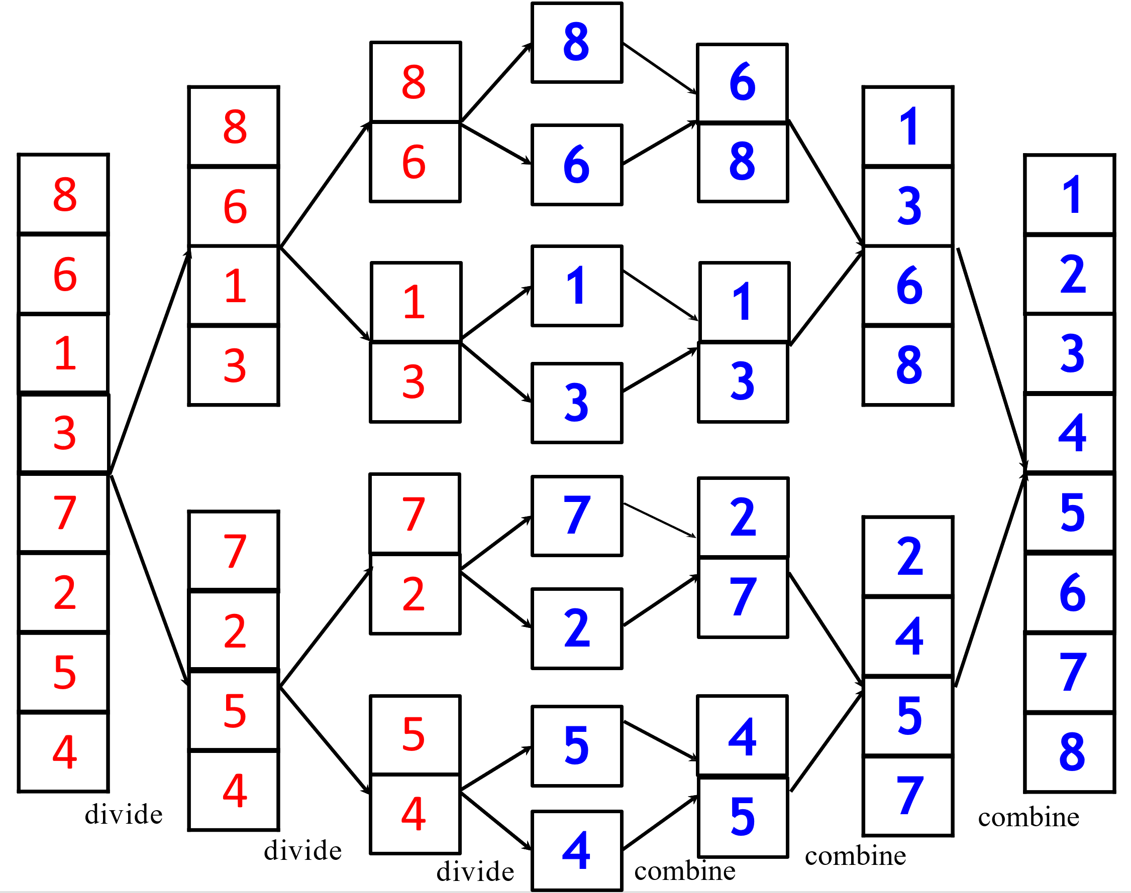

Slide 27
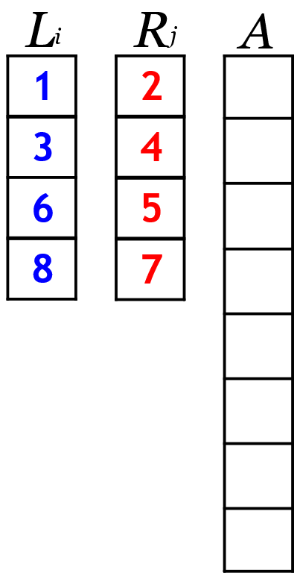
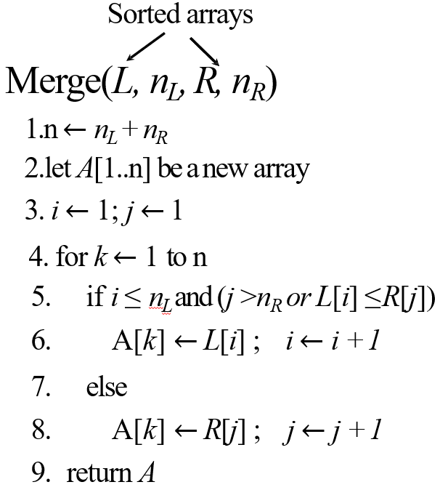
Combine Phase

Slide 28
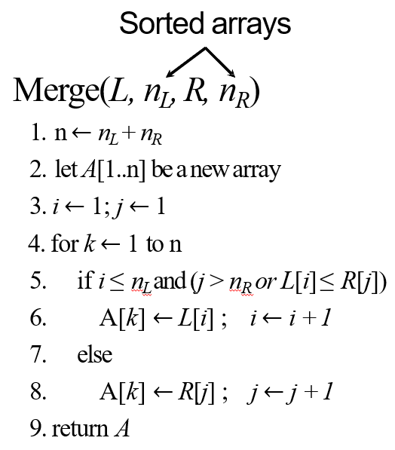
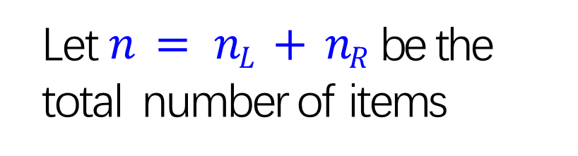

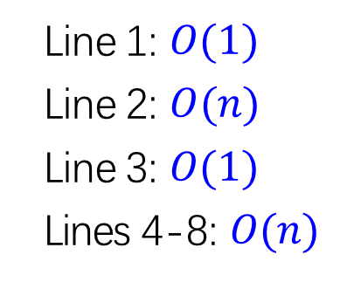
Time Complexity
Let $n = nL + nR$ be the total number of items
Line 1: $O(1)$
Line 2: $O(n)$
Line 3: $O(1)$
Lines 4-8: $O(n)$
Time of Merge: $O(n)$ time

Slide 29
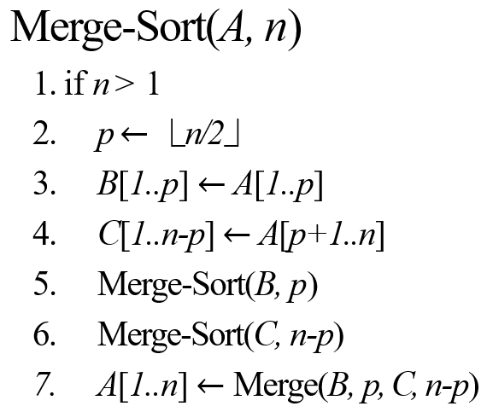

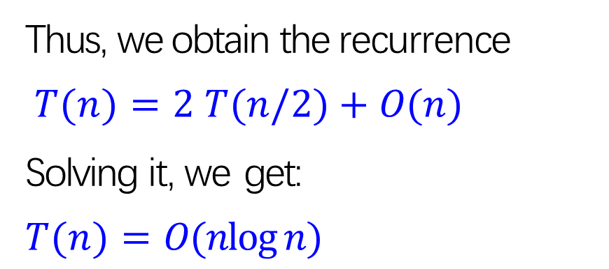
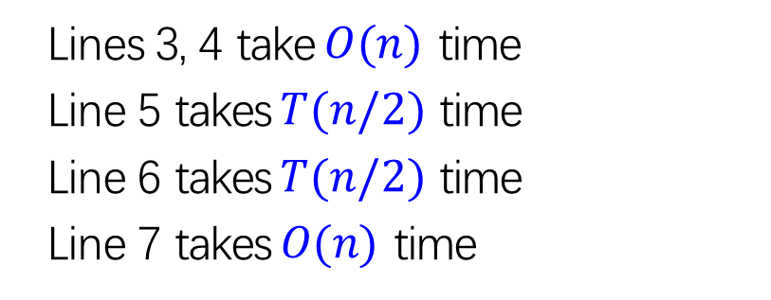
Time Complexity
Let $T(n)$be the running time of Merge Sort
Lines 3, 4 take $O(n)$ time
Line 5 takes $T(n/2)$ time
Line 6 takes $T(n/2)$ time
Line 7 takes $O(n)$ time
Thus, we obtain the recurrence $T(n)=2 T(n/2)+O(n)$
Solving it, we get:
$$T(n)=O(nlog⁡n)$$

Slide 30
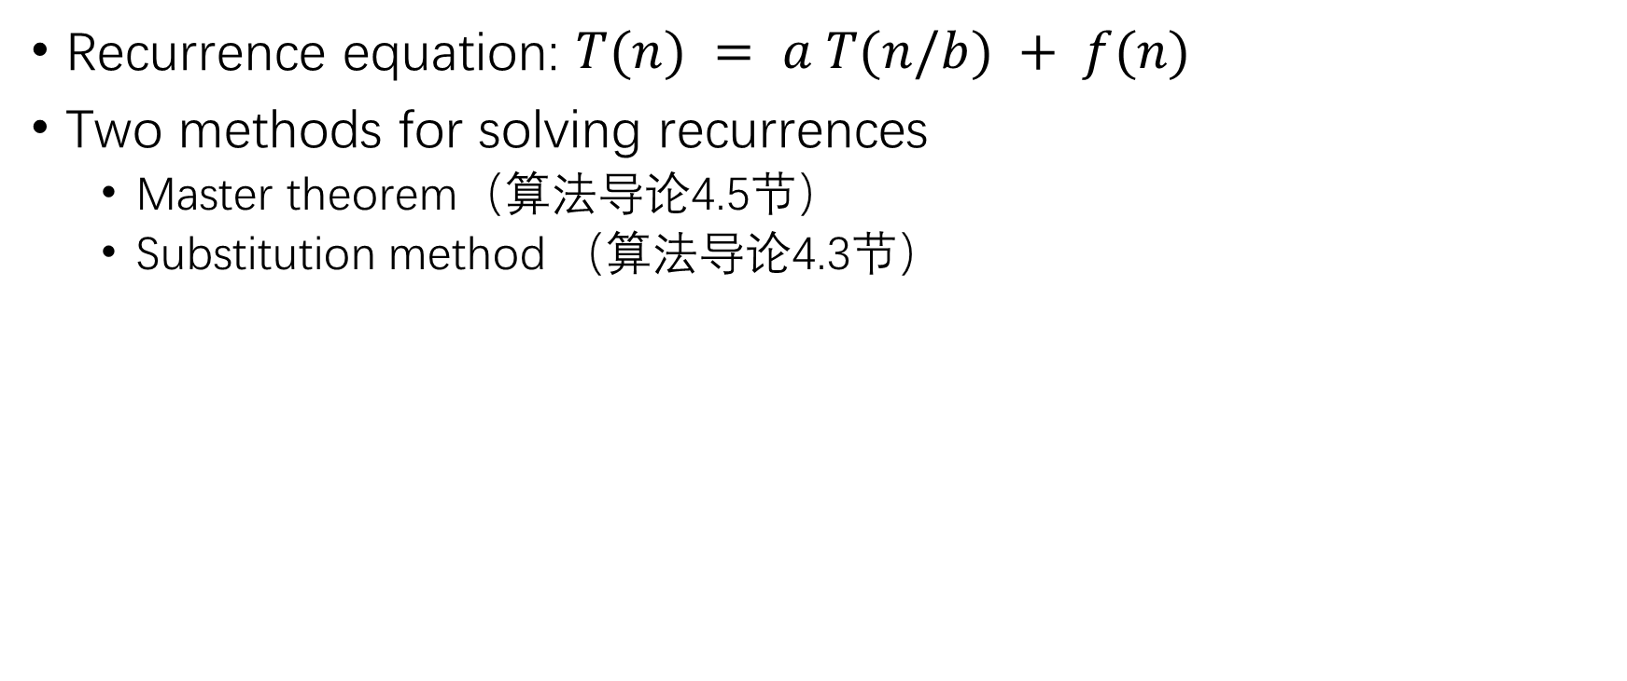
Methods for Solving Recurrences
Recurrence equation: $T(n) = a T(n/b) + f(n)$
Two methods for solving recurrences
Master theorem（算法导论4.5节）
Substitution method （算法导论4.3节）

Slide 31
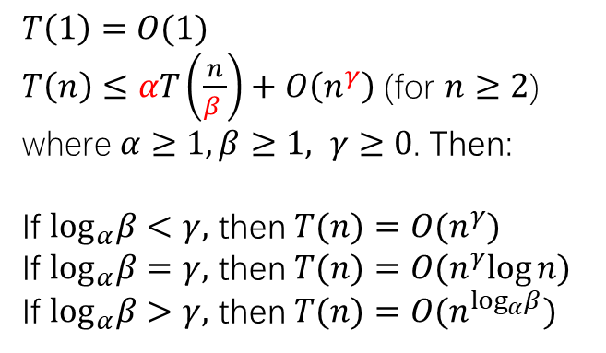
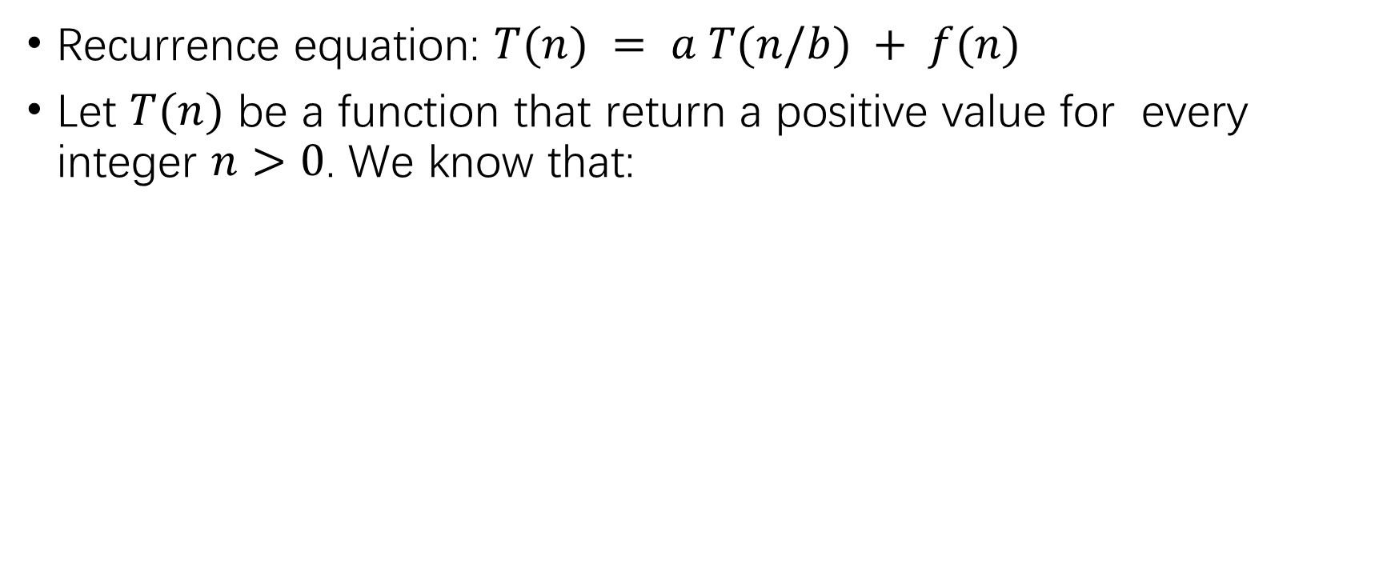
Master Theorem
Recurrence equation: $T(n) = a T(n/b) + f(n)$
Let $T(n)$ be a function that return a positive value for every integer $n>0$. We know that:
$$T\left(1\right)=O(1)$$
$T\left(n\right)≤αT\left(\frac{n}{β }\right)+O\left(n^{γ}\right)$ (for $n≥2$)
where $α≥1,β≥1, γ≥0$. Then:
If $\log_{α}β<γ,$ then $T(n)=O(n^{γ})$
If $\log_{α}β=γ,$ then $T(n)=O(n^{γ}log⁡n)$
If $\log_{α}β>γ,$ then $T(n)=O(n^{\log_{α}β})$

Slide 32
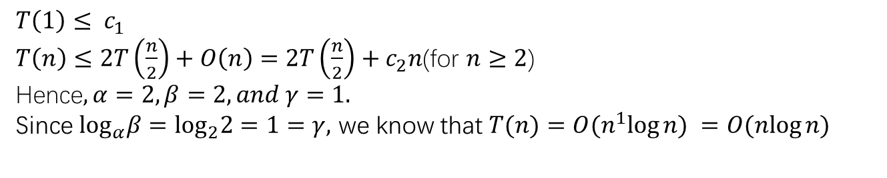
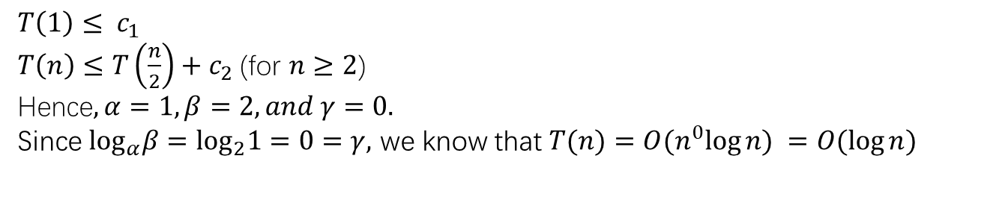
Master Theorem
Consider the recurrence of binary search:
Consider the recurrence of merge sort:
$$T\left(1\right)≤ c_{1}$$
$T\left(n\right)≤T\left(\frac{n}{2}\right)+c_{2}$(for $n≥2$)
Hence$, α=1,β=2,and γ=0.$
Since $\log_{α}β=$ $\log_{2}1=0=γ,$ we know that $T(n)=O(n^{0}log⁡n) =O(log⁡n)$
$$T\left(1\right)≤ c_{1}$$
$T\left(n\right)≤2T\left(\frac{n}{2}\right)+O\left(n\right)=2T\left(\frac{n}{2}\right)+c_{2}n$(for $n≥2$)
Hence$, α=2,β=2,and γ=1.$
Since $\log_{α}β=$ $\log_{2}2=1=γ,$ we know that $T(n)=O(n^{1}log⁡n) =O(nlog⁡n)$

Slide 33
Quick Sort
A special one

Slide 34
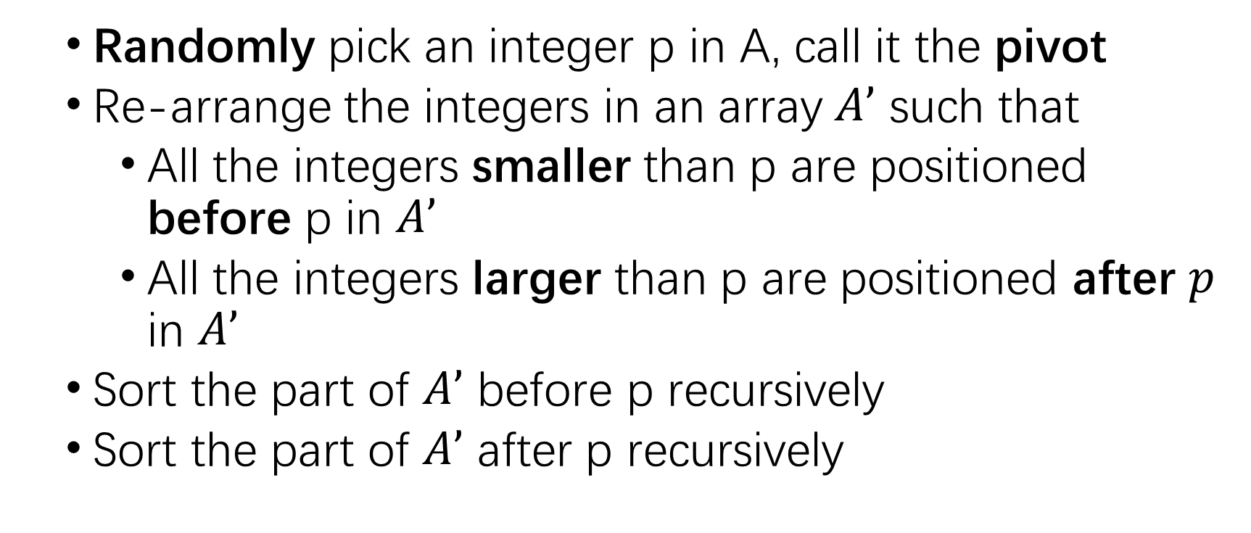
Idea
Randomly pick an integer p in A, call it the pivot
Re-arrange the integers in an array $A’$ such that
All the integers smaller than p are positioned before p in $A’$
All the integers larger than p are positioned after $p$ in $A’$
Sort the part of $A’$ before p recursively
Sort the part of $A’$ after p recursively

Slide 35
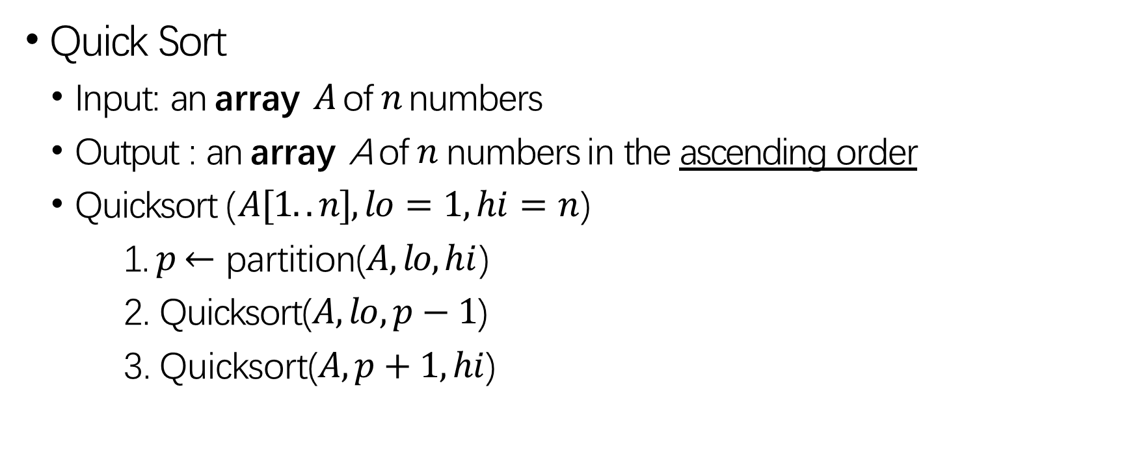
Algorithm
Quick Sort
Input: an array $A$ of $n$ numbers
Output : an array A of $n$ numbers in the ascending order
Quicksort ($A[1..n], lo=1, hi=n$)
1. $p$ $←$ partition($A, lo, hi$)
2. Quicksort($A,lo,p−1$)
3. Quicksort($A,p+1,hi$)

Slide 36
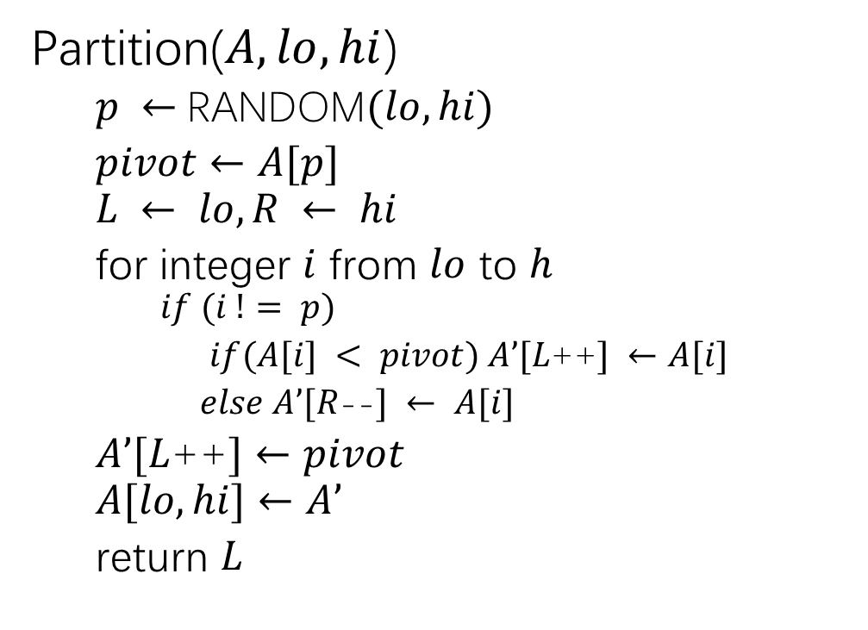
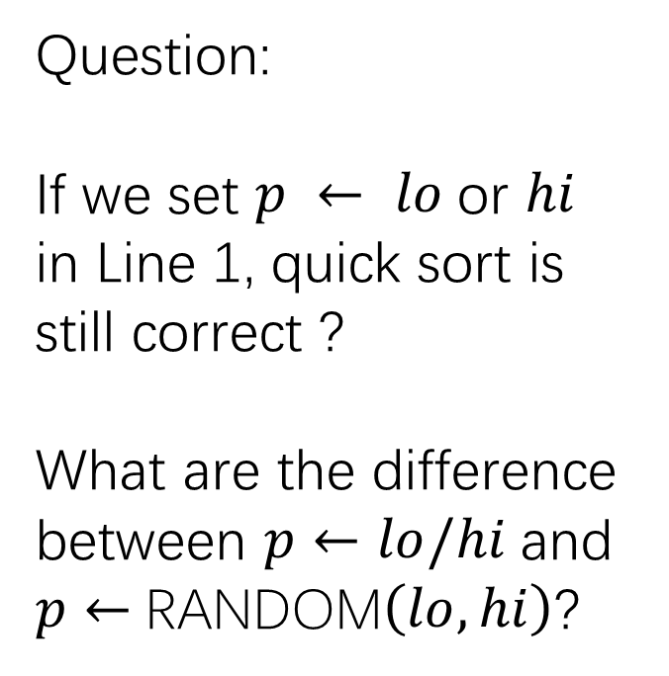
Algorithm
Partition($A, lo, hi$)
$p ←$RANDOM$(lo, hi)$
$pivot$ $←$ $A[p]$
$$L ← lo, R ← hi$$
for integer $i$ from $lo$ to $h$
$$if (i != p)$$
$if(A[i] < pivot) A’[L$++$] ←A[i]$
$else A’[R$--$] ← A[i]$
$A’[L$++$]←pivot$
$$A[lo, hi]←A’$$
return $L$
Question:
If we set $p ← lo$or $hi$ in Line 1, quick sort is still correct ?
What are the difference between $p←lo/hi$and $p←$RANDOM$\left(lo, hi\right)$?

Slide 37
8 | 6 | 1 | 3 | 7 | 2 | 5 | 4
pivot
1 | 3 | 2 | 5 | 4 | 6 | 7 | 8
pivot
1 | 2 | 3 | 5 | 4 | 6 | 7 | 8
pivot pivot pivot
1 | 2 | 3 | 4 | 5 | 6 | 7 | 8
pivot pivot
pivot pivot
pivot

Slide 38
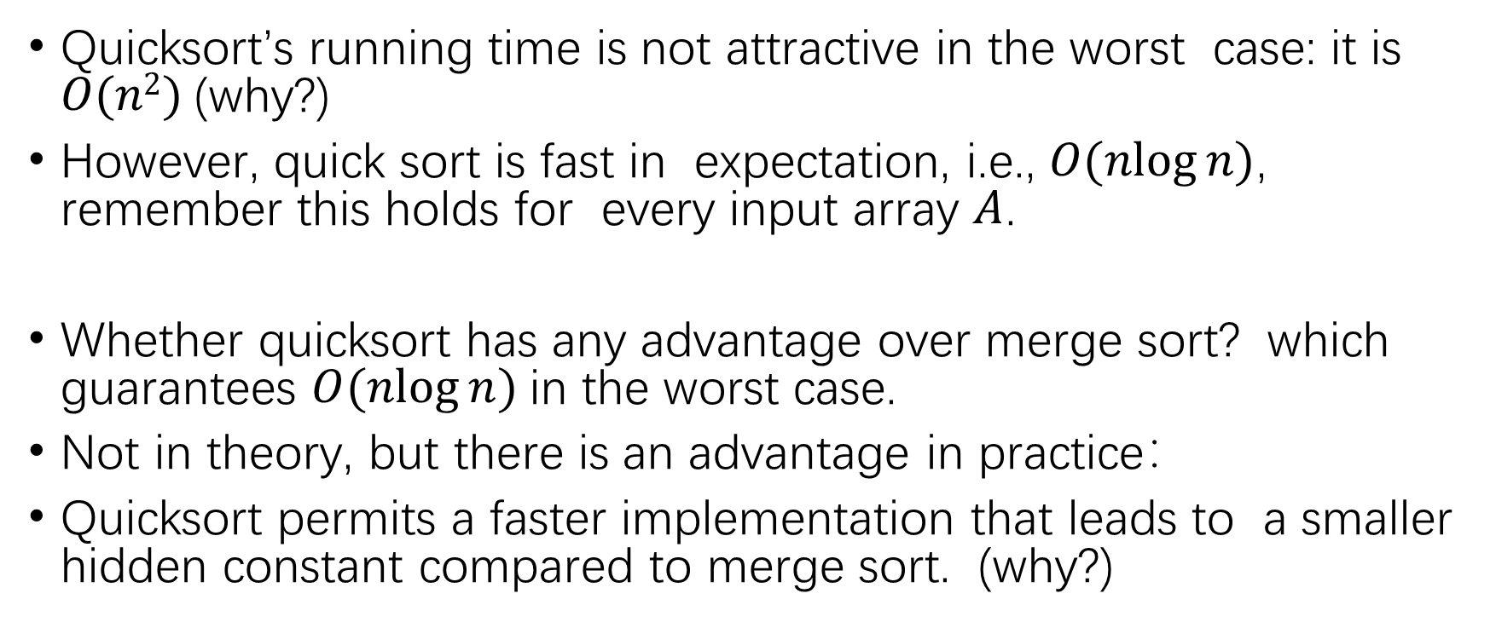
Time Complexity
Quicksort’s running time is not attractive in the worst case: it is $O(n2)$(why?)
However, quick sort is fast in expectation, i.e., $O(nlog⁡n)$, remember this holds for every input array $A$.
Whether quicksort has any advantage over merge sort? which guarantees $O(nlog⁡n)$in the worst case.
Not in theory, but there is an advantage in practice：
Quicksort permits a faster implementation that leads to a smaller hidden constant compared to merge sort. (why?)

Slide 39
Summary
Sort | Average | Space | Stable
Selection | O(n²) | O(1) | No
Insertion | O(n²) | O(1) | Yes
Bubble | O(n²) | O(1) | Yes
Heap | O(nlogn) | O(1) | No
Merge | O(nlogn) | Depends | Yes
Quick | O(nlogn) | O(1) | No
Lower bound of comparison-based sorting algorithms: $Ω (n (log⁡n ))$

Slide 40
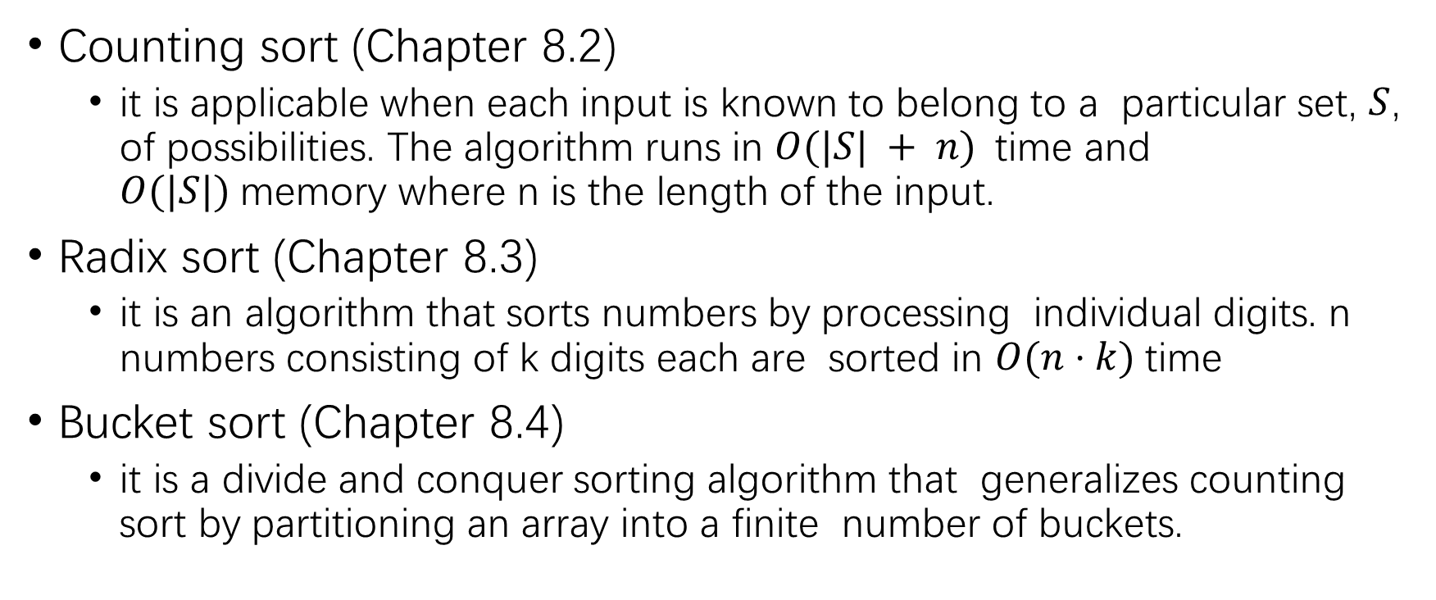
Other Methods
Counting sort (Chapter 8.2)
it is applicable when each input is known to belong to a particular set, $S$, of possibilities. The algorithm runs in $O(|S| + n)$time and $O(|S|)$memory where n is the length of the input.
Radix sort (Chapter 8.3)
it is an algorithm that sorts numbers by processing individual digits. n numbers consisting of k digits each are sorted in $O(n⋅k)$time
Bucket sort (Chapter 8.4)
it is a divide and conquer sorting algorithm that generalizes counting sort by partitioning an array into a finite number of buckets.

Slide 41
Thank you

